Slide 1
CAPSTONE PROJECT - KADATEMY 2022-01 COHORT
Team (Classification):
Ifunanya S. Anyanwu
HussainaAbdullahi
Ugochukwu Chukwunyere

Slide 2
OUTLINE
Introduction
Background/Overview
Problem statement
Aims
Data overview:
Data pre-processing
Descriptive analysis
Exploration of relationships
Predictions and evaluation
Discussion
Limitations and challenges
Lessons learned and conclusions

Slide 3
INTRODUCTION
This is a Capstone group project given to the Classification team of the 1st training cohort of Kadatemy in 2022. The group consists of three students who enrolled in the cohort and started training on coding with Python language in February 2022. The students include:
Ifunanya S. Anyanwu (Dr. STM)
Hussaina Abdullahi
Ugochukwu Chukwunyere
The essence of the project was to solidify all that has been learnt in the training span of three-four months and to build team work amongst the learners.
All codes that generated the findings in this project are attached to the GitHub file herein which are co-owned by the three contributors of this project.

Slide 4
BACKGROUND/OVERVIEW
This project is a challenge to find the main factors contributing to the high churn rate (i.e high rate of unsubscriptions from customers), of an internet service providing company. The dataset for the task was gotten from Kaggle - Telco Customer Churn dataset.
Based on our findings, we are to create a model that can predict the churn possibility of a potential client based on some given attributes, and to recommend solutions that can reduce churn.

Slide 5
PROBLEM STATEMENT AND AIMS
Churn is a common concern in subscription businesses and hence, most businesses are often looking out for ways to retain their customers while making efforts to recruit them. It typically costs businesses money to recruit new customers and this cost is increased when the clients are recruited and lost over a short period of time.
Based on this, the primary aims of this task is presented in the next section.
Aims of the task
To determine the characteristics of churn and not-churn clients in a given business entity
To determine which machine learning algorithm will best predict a customer churn tendency

Slide 6
DATA OVERVIEW

Slide 7
OVERVIEW
consists of 21 columns and 7,043 rows.
It includes information about the customer demography like their age, gender, etc.
Other columns include the various types of services people are subscribed to including phone service and internet services.
The internet services are further channelled off to online security, device protection, online support and etc.
The data also contain information about their payment characteristics such as payment method, and it contains other numerical values like tenure, monthly charges, total monthly charges,
and finally the churn characteristics of each case.
The duration of the tenure was measured in months. No information was given as to the currency of the monetary values in this dataset, nonetheless, we assumed the value to be USD.

Slide 8
DATA PRE-PROCESSING
We begin analyzing the customer dataset by preprocessing and checking for null values, removing unnecessary columns, and transforming certain values from column to better match with our data.
At a glance, the data had 21 columns, 7,043 rows, no missing cases, one float, two integer, and eighteen object types. However, on a more thorough examination of the columns, it was discovered that one of the columns had 11 missing cases which were simply left as empty cells and not “NaN”. On further inspection, we found the following:

Slide 9
these cases were missing at random (see this article here for more on missing cases)
The values in that column (Total Charges) were closely related to the product of two other columns (Tenure and Monthly charges)
All cases with a missing value in the concerned column equally had “0” as their respective “tenure”
Based on these findings, the missing cases were filled as 0, since the product of their tenure (0) with any monthly charge will remain as “0”.
Lastly, the customer ID column was removed because it’s of negligible contribution to the task.

Slide 10
Descriptive analysis
The findings from this stage of our analytics are presented below using figures and texts. To begin with, we look at the distribution of the primary dependent variable.

Slide 11
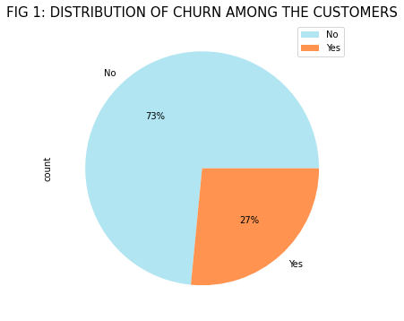
CHURN
From Figure 1 above, it can be seen that 27 out of 100 clients in this business churned.
To further understand the characteristics of the cases, we looked at their demographic details which is presented below:

Slide 12
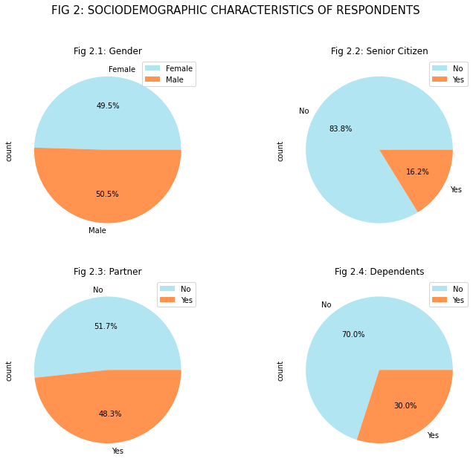
They were almost equally males (50.5%) and females (49.5%), but most (83.8%) were not senior citizens while those who had partners (48.3%) was again almost in equal proportion with those who do not have. Furthermore, only 30.0% of them had dependents.

Slide 13
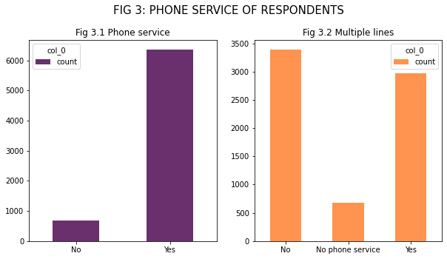

Slide 14
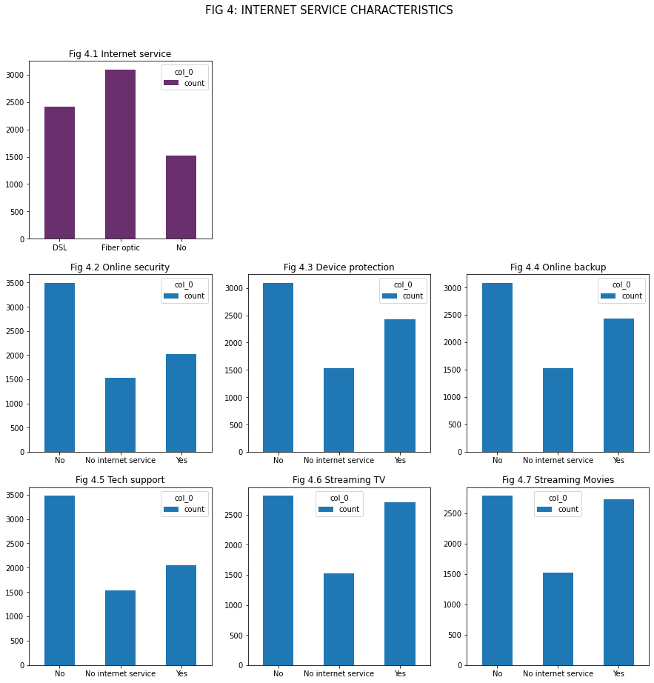
in Figure 4 below, it can be seen that about 20% of them do not have an internet service and amongst those who have, Fibre optic was the commonest type (Fig 4.1). Also, about the same proportion of them (≥2,000) had “device protection” (Fig 4.3), Online backup (Fig 4.4), TV streaming (Fig 4.6), and Movies streaming (Fig 4.7). Less than 2,000 had online security (Fig 4.2) and tech support (4.5).

Slide 15
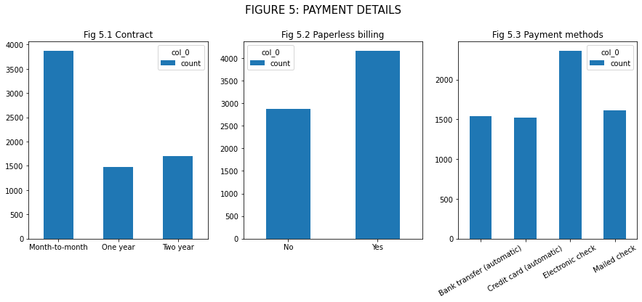

Slide 16
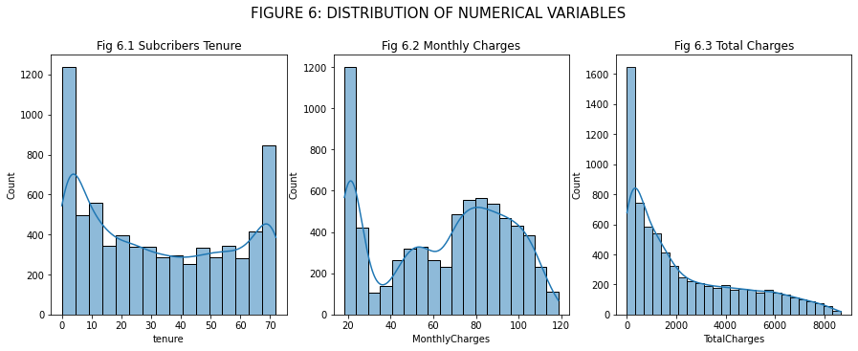
The mean tenure of subscribers was 32.37 months, while the mean monthly charges was 64.76 USD and the mean total charge was 2,279.73 USD. Furthermore, from Figure 6 below, it can be seen that none of the variables completely normally distributed - Total charges 9fig 6.3) was skewed to the right while monthly charges (Fig 6.2) and subscribers’ tenure (fig 6.1) had two peaks.

Slide 17
EXPLORATION OF RELATIONSHIP

Slide 18
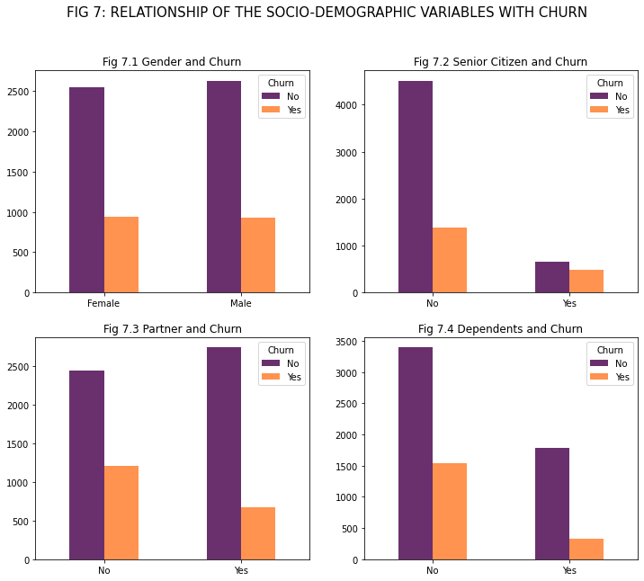
The distribution of churn vs non-churn clients was about the same for gender (Fig 7.1) and partner (Fig 7.3) but those who have dependents seem to be less likely to churn than their counterparts (Fig 7.4) and senior citizens appeared to be a bit less stable and tolerant than the non-senior citizens (Fig 7.3).

Slide 19
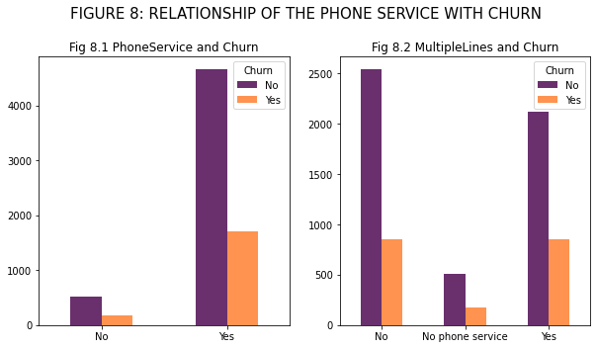
No particular pattern was established for phone service as those who had phone service(s) almost churned in the same manner as those who hadn’t (Figure 8.1). Furthermore, there was no apparent difference between those who had multiple lines and those that hadn’t (Fig 8.2)

Slide 20
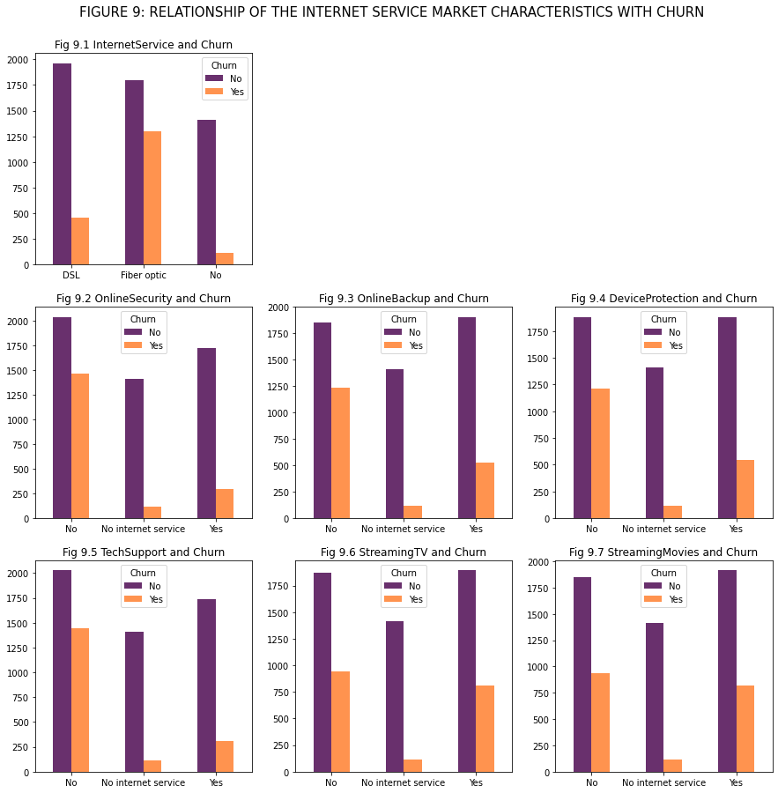
about the internet service subscription and churn (Figure 9); Figure 9.1 showed that most people who use Fiber optic for their internet services churned more than the other groups.Furthermore, those who hadn’t online security (Fig 9.2), online backup (Fig 9.3), device protection (Fig 9.4) and tech support (Fig 9.5) were far more likely to churn than those who had these services or those completely without internet service. The curn ratio is about the same for whether the cases streamed movies (Fig 9.7) or TV (Fig 9.6) or not.

Slide 21
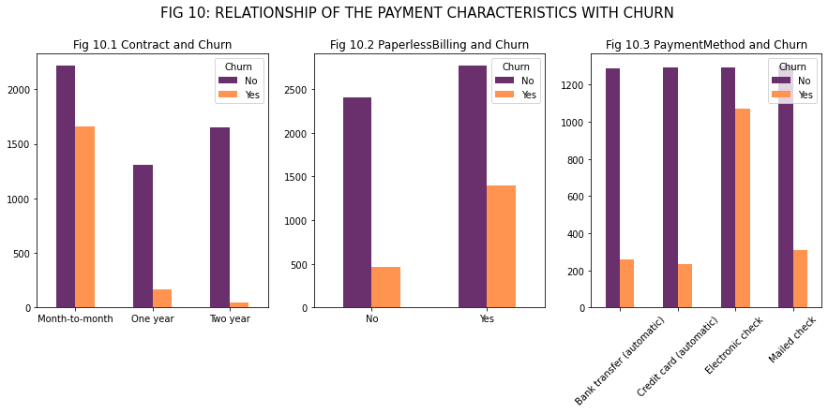
An interesting pattern was seen with respect to their churn characteristics and their payment characteristics (Figure 10). The churn rate was remarkably high in those with month-to-month contract (Fig 10.1), those with paperless billing (Figure 10.2), and those with electronic check (Figure 10.3).

Slide 22
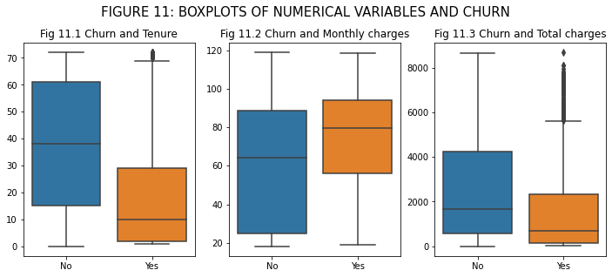
Lastly, comparing the numerical variables with the churn/non-churn characteristics (Figure 11). The pattern was interesting. As likely guessed, the mean tenure and 50% inter-quartile tenure range of those who churned was expectedingly lower than those who did not (Fig 11.1). But interestingly, despite their overall short stay, they paid more than those who stayed longer (Fig 11.2), while probably because of their shorter stay, they had lesser total charges compared to their counterparts (Fig 11.3)

Slide 23
MACHINE LEARNING

Slide 24
After learning all about our data set and how it relates to each other, we went ahead to apply machine learning tools to determine which model will best be applied to predict customers’ churn tendency.
Three classification models were applied viz:
Random forest classifier
Decision tree classifier
Logistic regression
Five evaluation metrics were used to evaluate the performances of each model viz:
f1 score
Accuracy score
Precision score
Recall score
Confusion matrix

Slide 25
The dependent variable was obviously “Churn”, with the possibility of to churn or not to. The variables included in the predicting model include:
Gender
Senior citizen
Having a partner
Having a dependent
Tenure
Phone service
Internet service
Contract
Paper-less billing
Payment method
Monthly charges, and
Total charges

Slide 26
Furthermore, the data was split using a ratio of 80/20, and SMOTE over-sampling was used to establish balance for each of the models.
Following the complete training of each model, they were tested and evaluated using the above metrics and the findings are presented below.

Slide 27
Table 1: Evaluation metrics of the classification models (All scores are in %)
CLASSIFIER | f1 score | Accuracy score | Precision score | Recall score | Specificity (TN/TN+FP)
Random forest | 55.21 | 78.35 | 56.12 | 54.34 | 82.29
Decision tree | 49.67 | 72.96 | 45.74 | 54.34 | 84.17
Logistic regression | 60.23 | 73.38 | 47.57 | 82.08 | 91.80

Slide 28
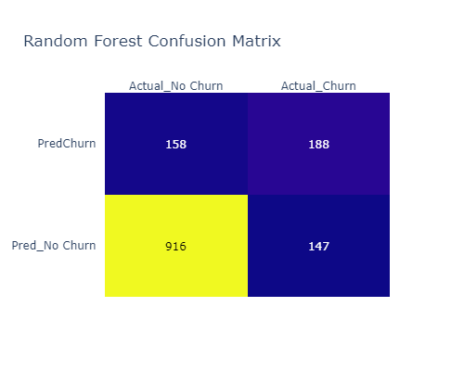
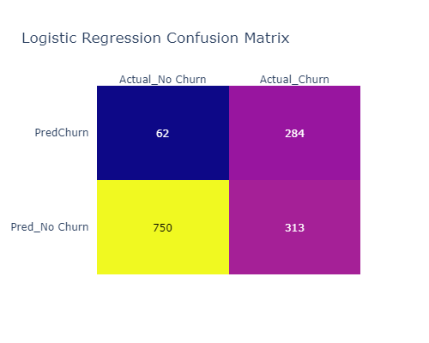
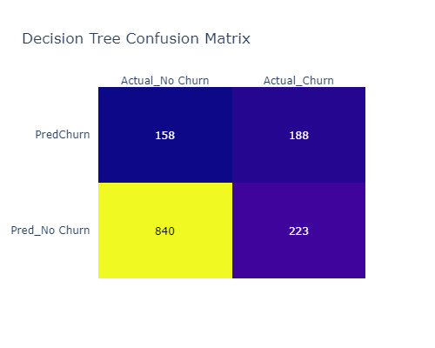
CONFUSION MATRIX

Slide 29
DISCUSSION
According to Viadinugroho (2021), specificity metric is used to measure the fraction of negative patterns that are correctly classified, best used when the data is imbalanced and the minority class is a negative class, for example, churn dataset.
Based on this, our models were primarily evaluated based on the specificity score which is calculated as TN/(TN + FP). Based on this, the best performing model is the Logistic regression with a score of 91.80%. It also scored as the best for the recall and the f1 scores. Hence, it can be said that the logistic regression model in this case will be best used to predict whether or not a customer will churn, based on some given attributes.

Slide 30
Limitations and Challenges
We have successfully learned a lot through the course of this project, however, the biggest challenge in this project include:
Limited available time
Different time zones for the contributors
Subotimal understanding of interpretation of evaluation metrics

Slide 31
Lessons learned and conclusions
Customer churning is a big concern for businesses because of the cost implications it means for the business. Hence, no matter how little the churn rate, it is important for businesses to have data-backed evidence on predicting whether a client will churn not based on their attributes and further making targeted interventions for people with those peculiar attributes.
Via this project, we have broadened our knowledge and understanding of machine learning. We have also integrated all we learnt throughout the course of this training and practicalised here. Working with a real life dataset has also walked us through some of the little necessities to watch out for while handling data in the future.

